Slide 1


Presentation Package for
Concepts of Physical Fitness 14e
All rights reserved
Section I: Concept 02:
Self-Management and Self-Planning Skills for Health
Behavior Change
Learning and regularly using self-management skills can help you adopt and maintain healthy lifestyles throughout life.
Notes:
1
This presentation covers the implications of lifestyle behaviors on health and provides some preliminary information on theories of behavior and strategies used to modify lifestyles.

Slide 2
Making Lifestyle Changes
Many adults want to make lifestyle changes but are unable to do so.
A "lifestyle" is more than the way we spend our time!
  “Lifestyles” are the behaviors that we adopt based on the context of our life circumstances.
Takes time to change
People progress forward and backward through several stages of change.
Notes:
Many adults want to make healthy lifestyles but find it difficult to make the changes. To understand these factors it is important to understand the definition of a “lifestyle”.
In this course, “lifestyles” are the behaviors that we adopt based on the context of our life circumstances

Slide 3
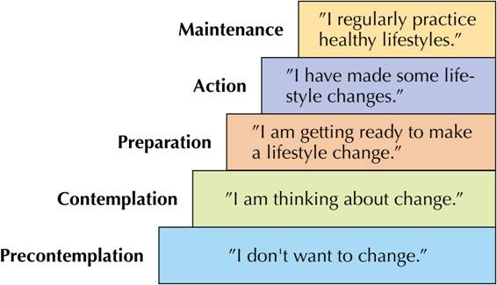
Stages of Change
Web 02-1
Research shows that people advance through a series of stages as they attempt to change behaviors
At what stage are you?
See:
Lab 2a
Lab 2a info
Notes:
10
10
The stages of change is a model developed by Dr. James Prochaska to explain the processes people go through in changing their behaviors. It was originally developed to explain the stages people use to change negative behaviors such as smoking but has recently been extended to help explain stages of exercise behavior.
People in precontemplation are not really interested in beginning an exercise program. Efforts at motivating them will probably fall on deaf ears since they are not even interested in the idea of starting an exercise program. Individuals in contemplation are beginning to think about starting but don’t know where to start. Individuals in preparation have taken some initial steps at beginning a regular exercise program. Those in action are doing regular exercise and those in maintenance have been doing it regularly for more than 6 months. Ask students what category they fall into.
Prochaska, J.O., DiClemente, C.C., and Norcross, J.C. (1992). In search of how people change: applications to addictive behaviors. American Psychologist 47(9): 1102-1114.

Slide 4
Pros and Cons of Physical Activity Across Stages
Notes:
In terms of decision balance, the stages of change model suggests that benefits and costs will be different depending on what stage a person is at.
People in precontemplation will have much higher scores on the Cons of Exercise compared with the Pros while people in maintenance will be the opposite. In the Preparation stage the levels of both aspects are about equal indicating that they are trying to change but still find significant barriers to participation.

Slide 5
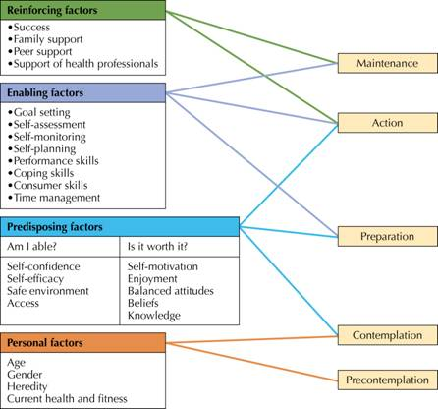
Factors that Promote Lifestyle Change
Notes:
5
5
This figure is very important as it is shows the relationship between the stages of change model and self-management skills.
Predisposing factors help precontemplators get going—moving them toward contemplation or even preparation. Enabling factors
help those in contemplation or preparation take a step toward action. Reinforcing factors move people from action to maintenance and help those in maintenance stay there.
Personal factors affect health behaviors but are often out of your personal control.
The important point to comment on is that while all three factors exert a direct influence, they also can work indirectly. Reinforcing factors and Enabling factors can both influence our predispositions to adopt healthy behaviors.
Each of these factors will be discussed in the subsequent slides.

Slide 6
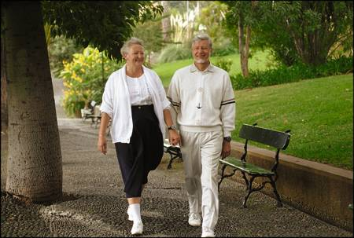
Predisposing Factors
Am I able?
  Self-confidence
  Self-efficacy
  Safe environment
  Access
Is it Worth it?
  Self-motivation
  Enjoyment
  Balanced attitudes
  Beliefs
  Knowledge
Notes:
6
6
Review the predisposing factors

Slide 7

Enabling Factors
Goal setting skills
Self-assessment
Self-monitoring
Self-planning
Performance skills
Coping skills
Consumer skills
Time management
Notes:
7
7
Review the enabling factors

Slide 8
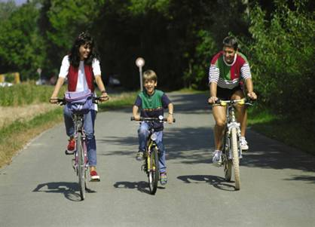
Reinforcing Factors
Success
Family Support
Peer Support
Support of health
professionals
Do societal norms “reinforce” healthy behavior?
Yes or No
Notes:
8
8
Review the reinforcing factors

Slide 9
Self-Management Skills
Skills you learn and practice to help you change and adhere to healthy lifestyles.
Also called self-regulation skills.
Lab 2b info
Notes:
3
The slide introduces the importance of self-management skills to establish positive lifestyles.
Use the slide to review the different self-management skills and to cover the behavioral lab on self-management skills.
Researchers have also identified several special skills, referred to as self-management skills, that can be useful in helping you
alter factors related to adherence and ultimately help you make lifestyle changes. Like any skill, self-management skills must be practiced if they are to be useful. The factors relating to adherence and the self-management skills described in this concept can be applied to a wide variety of healthy lifestyles. In early sections of this book, the focus is on using self-management skills to become and stay active throughout life. In the later sections of the book, the focus is on using these skills to adopt other healthy lifestyles that promote good health and wellness. In the final section, you get an opportunity to use the skills to make informed
choices and plan for healthy living.
Learning self-management skills can help you alter factors that lead to healthy lifestyle change.
Personal, predisposing, enabling, and reinforcing factors influence the way you live. These factors are of little practical significance, however, unless they can be altered to promote healthy lifestyles. Learning self-management
skills (sometimes called self-regulation skills) can help you change the predisposing, enabling, and reinforcing factors described in the previous slides. In fact, some of the enabling factors are self-management skills. It takes practice to learn these skills, but with effort anyone can learn them. There are many opportunities to learn self-management skills in this book. Many of the labs allow
you to practice these skills.

Slide 10
Self-Management Skills
A major goal of the class is to help you develop self management skills so that you can maintain an active and healthy lifestyle
Different self management skills are needed for predisposing, enabling and reinforcing factors.
Notes:
The following slide provides specific skills needed for predisposing, enabling and reinforcing factors.

Slide 11
Self Management Skills
Changing Predisposing Factors
  Overcoming barriers
  Building self confidence and motivation
  Balancing attitudes
  Building knowledge and changing beliefs
Notes:
Changing Predisposing Factors – Refer them to Table 1, p. 26

Slide 12
Self Management Skills
Changing Enabling Factors
  Goal setting skills
  Self-assessment skills
  Self-monitoring skills
  Self-planning skills
  Performance skills
  Adopting coping skills
  Learning consumer skills
  Managing time
Notes:
Changing Enabling Factors – Refer to Table 2, p. 27

Slide 13
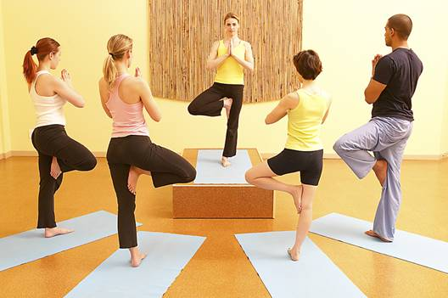
Self Management Skills
Changing Reinforcing Factors
  Finding social support
  Preventing relapse
Notes:
Changing Reinforcing Factors – Refer to Table 3, p. 28

Slide 14
Self-Planning for Healthy Lifestyles
Clarifying reasons for exercise
Identifying needs
Setting personal goals
Selecting program components
Writing your plan
Evaluating progress
See subsequent slides for additional information about each category.
Notes:
5
Self-planning is a particularly important self-management skill. A goal of this book is to help you develop a personal plan for adopting and maintaining healthy lifestyles. In this concept you will be introduced to a six-step self-planning process.
Review the steps for planning.
Step 1: Clarify and define your reasons for wanting to change a behavior. Identifying your reasons for wanting to change will help you determine which behaviors you want to change first and will help you establish specific goals. It is important to reflect on your reasons for wanting to make lifestyle changes before moving on to step 2.
Step 2: Identify your needs. This is done by self-assessment.
Step 3: Set goals that address your needs. Realistic SMART goals
Step 4: Select program components. The components depend on the goals of the program.
Step 5: Prepare a written plan, which can improve your adherence to the program.
Step 6: Evaluate your progress through self-assessment and self-monitoring.
. If your goal is weight loss then the type of program you would use would be different than someone trying to run a 10k race.
The 5th step is to write down plans: (goals that are not written down are just "dreams")
The 6th step is to evaluate whether your program is effective or not and make changes accordingly.

Slide 15
Step 1: Clarify Reasons
Reasons should reflect why you think you would like to be active.
  Examples: feel better, have more energy, social benefits etc...
Reasons are NOT goals but rather statements that help you identify the benefits that are most important to you.
Notes:
Review common reasaons.

Slide 16
Step 2: Identify Needs
Z
Z
Because fitness is multi-dimensional, it is important to strive for the health standard (Good) for each dimension.
High performance is NOT necessary for good health.
HIGH PERFORMANCE
O
O
GOOD
N
N
MARGINAL
E
E
LOW
S
S
Notes:
9
These are the Fitness Zones used to describe how fit a person is. Note that the labels are not value based (excellent or poor) but rather criterion based (low, marginal, good). Fitness tests should be used for educational, motivational and prescriptive purposes. The use of value or percentile norms places too much emphasis on competition and performance.
Note that the top level of fitness is the high performance zone. It is not considered to be the goal for the average exerciser because the amount of exercise needed to attain the high performance zone may not be considered healthy.
- Relate to the potential for injuries from high level training
- Relate to the extremely low levels of body fat found in many athletes

Slide 17
Step 3:
Setting Personal Goals
Web 02-4
Most people find better success when using behavioral (process) goals rather than outcome (product) goals
Goals are most effective
when they are put in writing
My Goals
Click for goal
setting guidelines
Notes:
6
Goals can be of several different types. Behavioral goals just signify that you plan on doing a certain behavior. Outcome goals define more specifically how much you would like to improve. Both can be used for fitness programs.

Slide 18
Step 4:
Selecting Program Components
Weight control
Cardiovascular fitness
Muscular Fitness
Health
Program plans will be different depending on the focus of your program.
Notes:
8
Review how to set up programs for different goals. For example, if the goal is to become more fit and physically active, the program components will be the activities you choose. You will want to identify activities that match your abilities and that you enjoy. You will want to select activities that build the type of fitness you want to improve.
In particular, remind students that the amount and intensity of exercise needed for general health is less than that needed to improve fitness.
More detailed information on exercise prescriptions for specific goals is available with the hyperlink.

Slide 19
Step 5: Writing Your Plan
Pledge or promise to be active
Can facilitate adherence to your program
Include daily plans with scheduled times and other program details
Notes:
Discuss the importance of making plans for a behavior change.
For example, the daily written plan for stress management could include the time of day when specific program activities are conducted (e.g., 15-minute quiet time at noon, yoga class from 5:30 to 6:30). An activity plan could include a schedule of the
activities for each day of the week, including starting and finishing time and specific details concerning the activities to be performed. A dietary plan might include specific menus for each meal and between-meal snacks.
Refer students to the lab in this last concept on initiating a long term plan for the semester.

Slide 20
Step 6: Evaluating Progress
Provides feedback and lets you know what types of programs or exercises work best for you.
Self-monitoring
  Dietary log
  Pedometer
Self-assessments
  Use same ones as in beginning to evaluate your progress
Notes:
Review importance of logging and tracking of health behaviors.

Slide 21
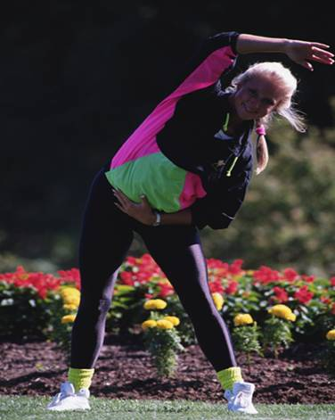
Program Planning Suggestions
Find activities that
you enjoy
Start gradually
Make exercise fun
Vary your program
Use warm-up/cool-down
Notes:
15
These are some additional program planning suggestions (review and elaborate).

Slide 22
Pre-planned Exercise Programs
Commonly found in magazines, TV and the web.
  May not be well designed to suit your needs.
Criteria for evaluating pre-planned programs:
  Who wrote it?
  Does it have multiple levels?
  Does it meet your needs?
  Do you enjoy it?
  Can you adapt it?
Notes:
13
Preplanned exercise programs are quite popular. You can find them in magazines, books, videos etc. Many may be poorly designed and may not meet your individual needs. Just because it works for one person does not mean it will work for you.

Slide 23
Theories /Models of Healthy Lifestyle Adoption
Transtheoretical Model
Health Beliefs Model
Social Ecological Model
Theory of Reasoned Action
Social Cognitive Theory
Theory of Planned Behavior
Self-Determination Theory
‘Web02-07 has resource links on each of these theories
Web02 - 07
Notes:
14
Refer to Table 6, p. 34
Many theories of behavior have been created. The health beliefs model and the theory of planned behavior are two of the more common models. Discuss these models or discuss why it is often hard to change behaviors.
Additional information on these models is available on the Web review pages on the Internet.

Slide 24
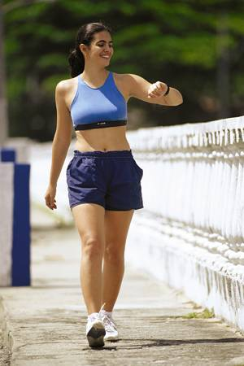
Guidelines for Promoting
Exercise Adherence
Avoid comparisons
with others
Do not expect
immediate results
Exercise as a reward
NOT as a punishment or chore!
Notes:
14
14
Discuss some guidelines for promoting exercise adherence.
- Avoid emphasis on winning: There will always be someone stronger, faster etc.
- Avoid comparisons with others:: Exercise for your self
- Don’t expect immediate results: Be patient

Slide 25
Hints for Successful
Behavior Change
Make small changes
Reward your progress
Do not give up
Notes:
16
Slide covers additional suggestions for behavioral change
Aim for small changes:
Don't try to completely change diet just make a few simple corrections (ex. eating a piece of fruit, eating fast food only once a week)
Reward progress:
Be content with yourself and your efforts. Measure success by the process (your efforts) not the product.
Do not give up:
Behavior change is hard but that is all it is! If you keep trying you will learn from past mistakes and improve.

Slide 26
Web Resources
Online Learning Center
“On the Web” pages for Concept
Notes:
This page provides active hyperlinks if the computer is connected to the Internet.

Slide 27
Supplementary Graphics
Lab Information
Goal Setting Guidelines
Notes:
Supplementary graphics

Slide 28
Lab 2a Information
The Stages of Change Questionnaire
Return to
presentation
For each health behavior listed in The Stage of Change Questionnaire, assess your current “stage” in the stage of change hierarchy.
Place a check beside one level (for each behavior) that you think best represents your current stage.
Identify two health behaviors especially in need of change.
Notes:
Conclusions & Implications:
Identify two health behaviors especially in need of change (from the first six in the stages of change questionnaire. Identify your current stage for each and discuss the factors that you will consider when attempting to make a change. Write one paragraph of several sentences for each of the two behaviors.

Slide 29
Lab 2b Information
The Self-Management Skills Questionnaire
Return to
presentation
Complete the Self-Management survey.
Sum scores to get composite indicator of self-management skills
Discuss your rating and scores for physical activity, nutrition, and self-management
Discuss skills you could learn that would help you become a better “self-manager”
Discuss what self-management
is needed for other behaviors
Notes:
Lab information

Slide 30
Goal Setting Guidelines
Return to presentation
S.M.A.R.T. goals
Be realistic
Focus on exercise
Consider heredity
Consider maintenance
Set lifestyle goals
Put goals in writing
Notes:
7
These are some important goal setting guidelines. Review and discuss the guidelines. Provide suggestions for written goals as follows:
S.M.A.R.T. goals -
Specific
Measurable
Attainable
Realistic
Timely
Give examples of good objective goals
1. increase strength in bench press by 20 lbs. by the end of the semester.
2. to be able to run 3 miles nonstop by the end of the semester

