Slide 1

Irresponsible Sexual Behaviour

Slide 2
Learning Outcomes
At the end of the lesson, you will learn:
Knowledge:
  The repercussions of irresponsible sexual behaviour on self, others and society
  The implications of teenage pregnancy and its consequences on one’s present and future ambitions.
  Skills:
  Explore the feelings related to teenage pregnancy and its consequences
  Competencies
  Appreciating the beauty of responsible sexual behaviour.
  Considering the consequences of irresponsible sexual behaviour.

Slide 3


Slide 4


Slide 5
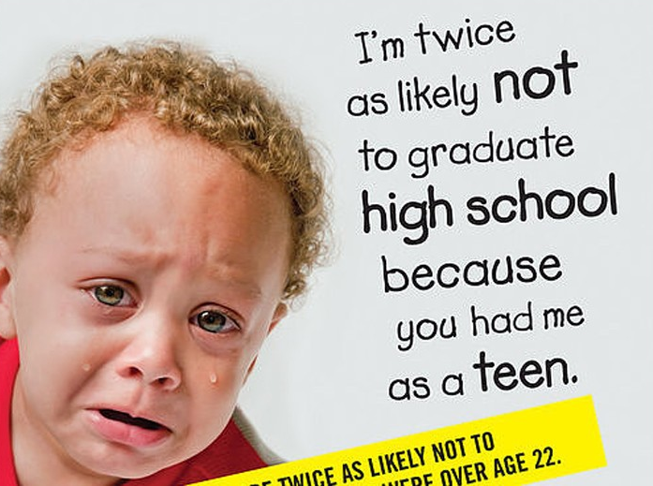

Slide 6


Slide 7


Slide 9
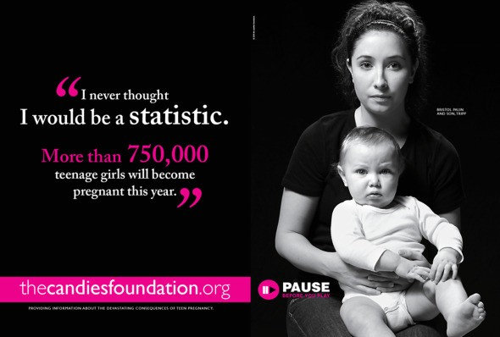

Slide 10
Brainstorming
What are the repercussions of irresponsible sexual behaviour on …
Myself
Others
Society

Slide 11
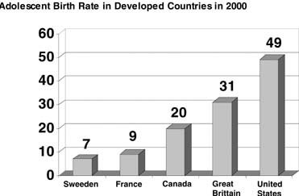
Teenage Pregnancies
The implications of teenage pregnancy and its consequences on one’s present and future ambitions.
Adolescent birth rate in developed countries. (Singh S, Darroch J: Adolescent pregnancy and childbearing: Levels and trends in developed countries. 2001)

Slide 12
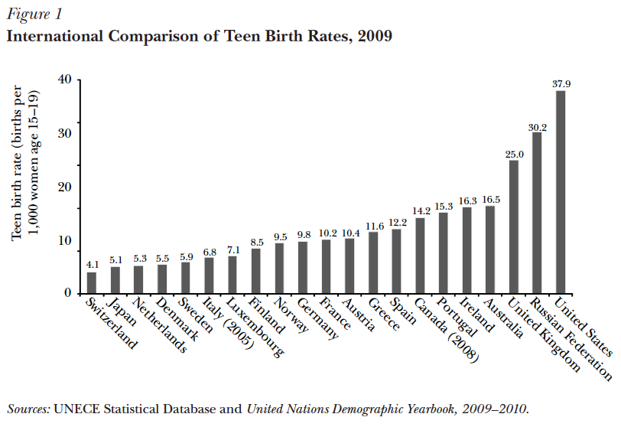

Slide 13
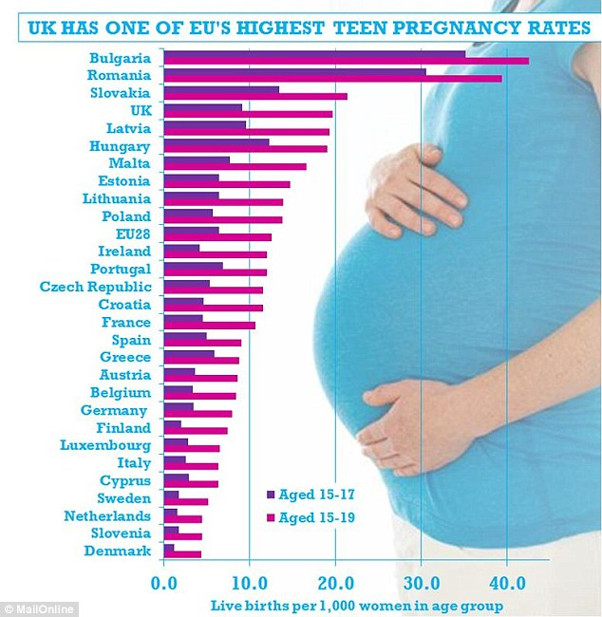
UK still has the highest rate of teen pregnancies in Western Europe despite 25% fall in the last decade
19.7 births per 1,000 women aged 15-19 in the UK in 2012, study shows.
Figure is much higher than the EU average of only 12.6 births per 1,000.
Worldwide figures show Switzerland had the lowest rate at 3.4 births.
The highest teen pregnancy rate was in Azerbaijan at 50.0 births.
By MATT CHORLEY, POLITICAL EDITOR FOR MAILONLINE
PUBLISHED: 15:19 GMT,
15 October 2014 |
UPDATED: 18:11 GMT,
15 October 2014

Slide 14
Teenage Pregnancy in Malta
(Newspaper articles)
Girl of 12 became a mother but teen pregnancies down (2015-07-15)
Teenage pregnancies too much too young (2012-09-10)

Slide 15
Teenage Pregnancy in Malta
As clinical psychologist Angela Abela puts it, "adolescence is not a time for having children".
"It is a time when adolescents strive to build their own identity in life, a time for investing in their future." Abela says single and teenage parenthood is still under-researched in Malta, and the 21% rate is very high, leading to concerns about the risk that these mothers fall under the poverty line. The National Statistics Office's survey on income and living conditions found the at-risk poverty rate for single parents was 56%.
"Research carried out by Charles Tabone and myself shows a strong relationship between economic poverty, a low level of education, limited employability, ill-health and poor integration in social life," Abela says.

Slide 16
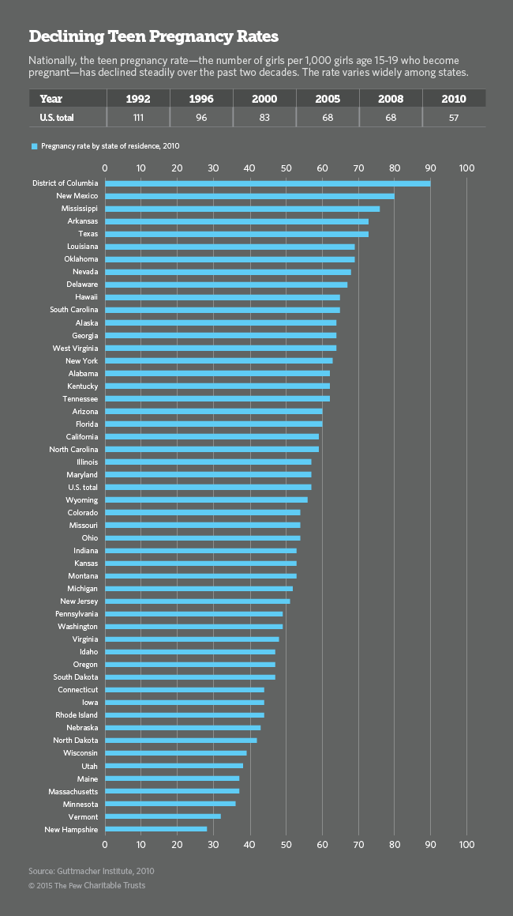
Teenage Pregnancies in the USA (2015)

Slide 17
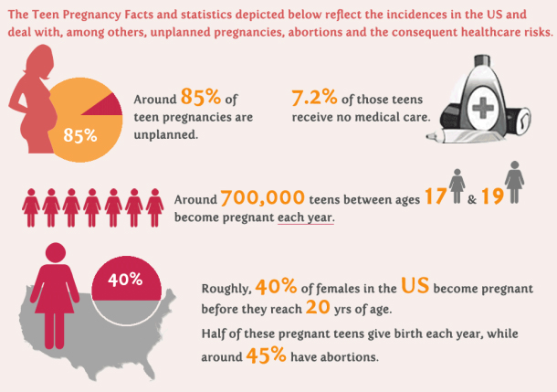
Teenage Pregnancies in the USA (2015)

Slide 18
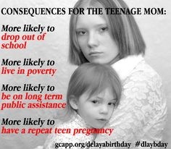
Teenage Pregnancies

Slide 19
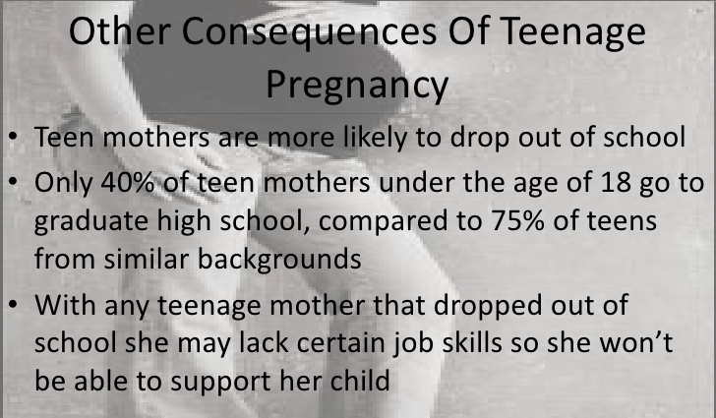
Teenage Pregnancies

Slide 20
Causes of Teenage Pregnancies
Early marriage.
Adolescent sexual behaviour – alcohol and drugs
Lack of sex education.
Peer pressure.
Sexual abuse – rape.
Poverty.
Exposure to abuse, violence and family strife at home.
Low self esteem – desperation.
Low educational ambitions and goals.
Media and social networks

Slide 21
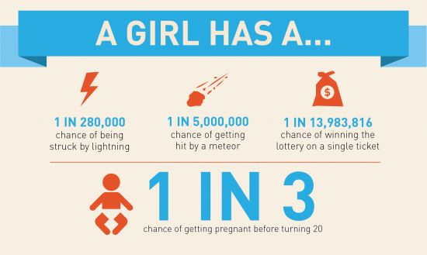
SKILLS

Slide 22
SKILLS
  Explore the feelings related to teenage pregnancy and its consequences.
  How do we feel about this topic?
  What if your current partner would tell you she that she is late on her period, how will you feel and react?
  What is the first thing that comes to mind?
  Once you calm down, what will you
  PLAN for your child and partner?

Slide 23
Teenage Pregnancy
https://www.youtube.com/watch?v=5RV_moBEUkk
https://www.youtube.com/watch?v=X2KHvrSO5xY

Slide 24
COMPETENCIES
Appreciating the beauty of responsible sexual behaviour.
Considering the consequences of irresponsible sexual behaviour.

Slide 25


Slide 26
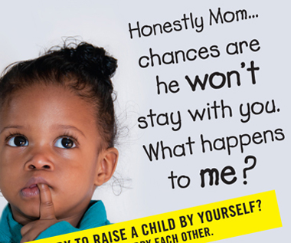
In Conclusion …

Slide 28
Funnels…

Slide 29
The Four Generalities of the Funnels…
Guys are generally AROUSED more quickly than girls: by smell, by the SIGN of anything SEXUAL. Girls take a good deal of SEXUAL contact to create as much AROUSAL.

Slide 30
…The Four Generalities of the Funnels
Girls send out SIGNALS to guys by the way they DRESS and the way they ACT.
Guys get outspoken PRESSURE from friends and society that it is expected that they make SEXUAL passes. Guys feel they have to “LIVE UP” to the masculine stereotypes of sexual macho and aggressiveness.

Slide 31
…The Four Generalities of the Funnels
Both guys and girls will move down the funnel until they reach a “POINT OF URGENT NEED” where control is lost and physical need takes over.

Slide 32
Comparing the Two Funnels…
The SPEED down each funnel varies.
Girls are usually more interested in pushing down the COMMITMENT funnel, guys control how and how FAST.
Guys are usually more interested in pushing down the INTIMACY funnel, girls control how far and how FAST.

Slide 33
…Comparing the Two Funnels
Girls and guys will use one funnel to bargain for the other. Girls give SEX to get LOVE, guys give LOVE to get SEX.
The earlier in age one enters the funnel, the LONGER one is faced with the problem of fighting gravity down the funnel.

Slide 34
…Comparing the Two Funnels
The more you DATE one person, the MORE SLIPPERY the funnel becomes.
It is easier to break off a RELATIONSHIP than it is to back up the funnel.

Slide 35
…Comparing the Two Funnels
Once you have gone down the funnel, future funnels are more SLIPPERY.
Going down the INTIMACY funnel gives girls a different reputation than guys.

Slide 36
Factors that Influence
Girls and Guys to have Sex…
Going Steady
Begin dating at an early age
Whether friends are SEXUALLY active or not
Alcohol and/or Drugs

Slide 37
Factors that Influence
Girls and Guys to have Sex…
Lack of involvement in RELIGION.
Parents and Family:
    A. Very PERMISSIVE or very STRICT.
    B. Lack of family VALUES.
    C. Divorced or SINGLE parents.
    D. OPPORTUNITY presented.
    7. How you feel about SCHOOL.

Slide 38
Factors that Influence
Girls and Guys to have Sex…
8. Dating OLDER guys/girls.
Feeling UNLOVED.
10. Media
11. Pressure from your PARENTS.

