Slide 1
Lateral thinking
Mr. Andre’ Damato

Slide 2
What is lateral thinking
Lateral thinking is a term coined by Edward de Bono, for the solution of problems through an indirect and creative approach.
Lateral thinking is about reasoning that is not immediately obvious and about ideas that may not be obtainable by using only traditional step-by-step logic.

Slide 3
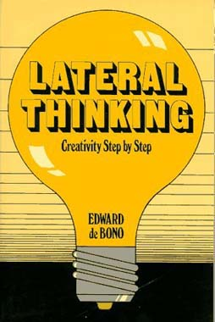

Slide 4
Puzzle 1
In the middle of the ocean is a yacht. Several corpses are floating in the water nearby.

Slide 5
Puzzle 2
A man and his wife raced through the streets. They stopped, and the husband got out of the car. When he came back, his wife was dead, and there was a stranger in the car.

Slide 6
Puzzle 3
A woman has incontrovertible proof in court that her husband was murdered by her sister. The judge declares, "This is the strangest case I've ever seen. Though it's a cut-and-dried case, this woman cannot be punished."

Slide 7
Puzzle 4
A man is found hanging in an otherwise empty locked room with a puddle of water under his feet.

Slide 8
Puzzle 5
A woman buys a new pair of shoes, goes to her regular work, and dies

Slide 9
Puzzle 6
A man is lying awake in bed, and cannot sleep. He makes a phone call, says nothing, and then goes to sleep.

Slide 10
Puzzle 7
Two men enter a bar. They are served identical drinks. One lives; the other dies.

Slide 11
Puzzle 8
Peter is wearing a mask and carrying an empty sack, leaves his house. An hour later he returns with a full sack. He goes into a room and turns out the lights.

Slide 12
Puzzle 9
A man dies of thirst in his own home.

Slide 13
Puzzle 10
There are a carrot, a pile of pebbles, and a pipe lying together in the middle of a field.

Slide 14
Puzzle 11
A man leaves a motel room, goes to his car, honks the horn, and return

