Slide 1
Personal Development
Health and Safety

Slide 2
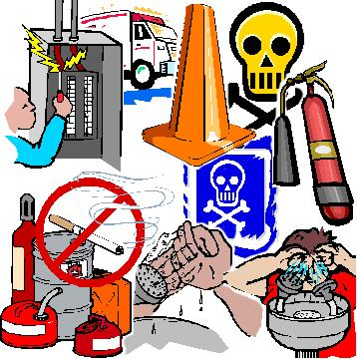
Health and Safety
Definition
  Occupational safety and health is the discipline concerned with preserving and protecting human and facility resources in the workplace.

Slide 3

Occupational Health and Safety in ICT
European regulations exist to protect the health and safety of employees who use computers for a considerable part of their working day.

Slide 4
Ergonomics (law at work)
Ergonomics is the study of how working conditions, machines and equipment can be arranged in order that people can work with them more efficiently.
  Seating - Chairs with adjustable height and back-rest are recommended. When seated correctly, the lower arms and thighs should be in a roughly horizontal position while working at the keyboard.
  Worktops - A fixed height between 660-730mm is required (720mm is recommended). A worktop depth of 760-840 mm is required to give the user sufficient distance from the screen while working. Matt worktops in a cream or beige colour are recommended in order to reduce glare.
Notes:
Ergonomics is the “study of efficiency of workers and working arrangements”

Slide 5
Cont....
  Screens - All new screens must be fitted with tilt and swivel stands. Sufficient room is needed for the screen to be moved back and forward. Ideally, the top of the screen should be at eye level.
  Lighting - Windows should be fitted with non-reflective blinds, preferably beige in colour. Consideration should be given to positioning of the screen away from light reflection and glare. The optimum position is at right angles to the source of natural light.

Slide 6

Hazards to Operator Health and Efficiency

Slide 7
Visual Fatigue
Screen glare
Poor character-definition on screen
Excessive periods of screen viewing
Screen flicker
Screen reflection
Insufficient or excessive ambient (surrounding) lighting
Frequent, excessive eye movement when switching between screen and document

Slide 8

Visual Fatigue cont…
Eye Strain - In order to reduce eyestrain, users should be encouraged to look away from the screen and focus on a distant object from time to time - this will relax their eye muscles.
The wearing of spectacles also helps prevent possible soreness caused by the bombardment of ionised dust particles from the screen.

Slide 9
Bodily Fatigue
Adopting poor seating posture
Bending frequently to reach various parts of the workstation
RSI
Holding the head at an awkward angle to view the screen or document

Slide 10
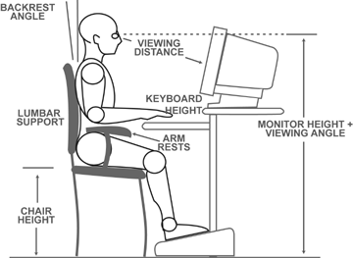

Slide 11
Repetitive Strain Injury (RSI)
This is caused by repetitive finger movements over very long periods of time.
Also called carpal tunnel syndrome
Special products are available to support wrists
Nerves at the edge of the hand can also become inflamed

Slide 12
Other Hazards
Electric shock
Static electric shock
Injury from impact
Muscular or spinal strain
Burns, cuts or poisoning caused by equipment breakdown

Slide 13
Analysis of Workstation Requirements
Users
Existing workstations
The location of the workstation
Workstation usage
Notes:
The various kinds of work to be carried out at a workstation may involve (Workstation Usage):
Data entry involving transcription from source
Use of large reference manuals
Storage of file media
customer enquiries which involve customers viewing the screen display
Side-by-side working with another member of staff
Use of a mouse which requires a flat surface area for its movement
Some activities which do not involve the use of a computer

Slide 14
Designing an Appropriate Workstation
Work surface
  Height
    Should have a thigh clearance of at least 180mm
    This could be insufficient for someone to sit cross legged
  Area
    Depends on the nature of work being carried out at the workstation

Slide 15
Designing an Appropriate Workstation
Chair
  Should be adjustable
  Support for the feet should be provided
  Footrest should allow for the thighs to be slightly raised from the front edge of the chair
  Should have lower back support

Slide 16
Designing an Appropriate Workstation
Cabling
  Avoid loose cabling under the desks
    Can cause injury to staff
    Hardware can be pulled and as a result be damaged or can result in loss of data and system use
Notes:
c

Slide 17
Designing an Appropriate Workstation
Office layout
  Temperature of room should be constant and comfortable
  Computer equipment should not be placed next to a heater due to overheating.
  Screens should be protected from direct sunlight
  Sufficient space for staff to move around
  Workstations should have sufficient space to allow routine maintenance and cleaning to be carried out
  Easy access to fire fighting equipment and fire exits should be kept clear

