Slide 1

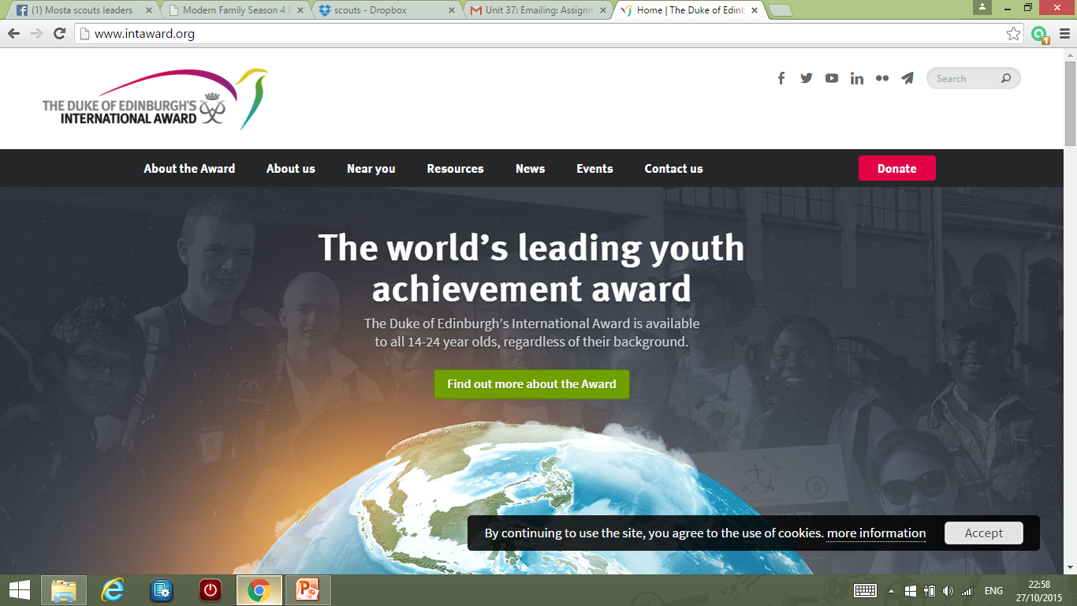

Slide 2
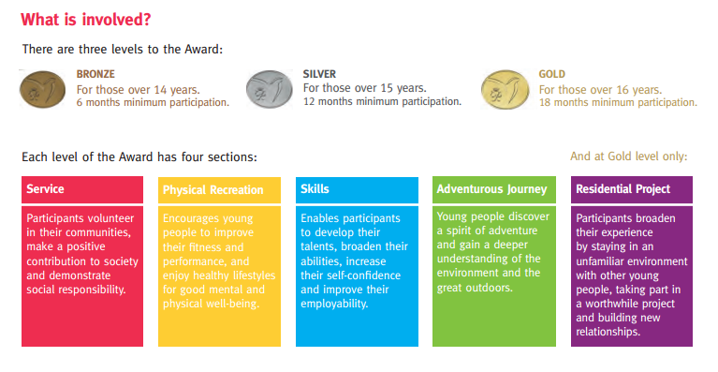

Slide 3
Participant time requirements
Level | Minimum period of participation
 | Direct entrants | Award holders
Bronze | 6 months | Not applicable
Silver | 12 months | 6 months (if Bronze holder)
Gold | 18 months | 12 months (if Silver holder)
It is a marathon, not a sprint!

Slide 4
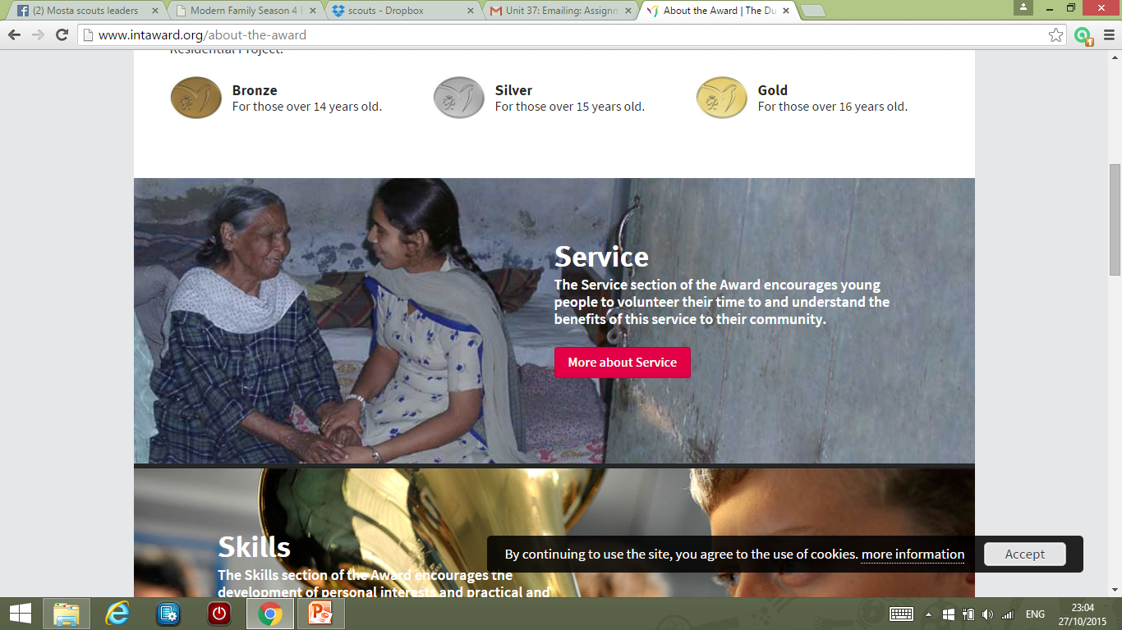
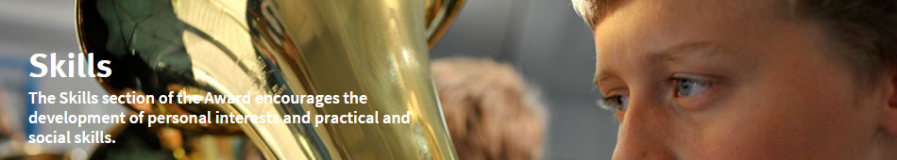

Three Main Areas

Slide 5
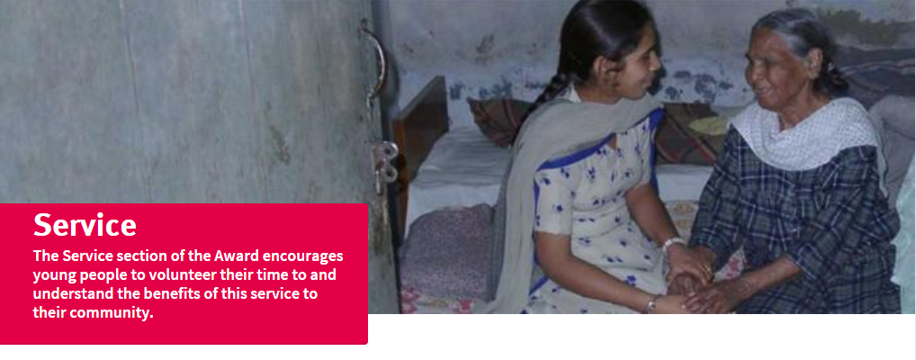
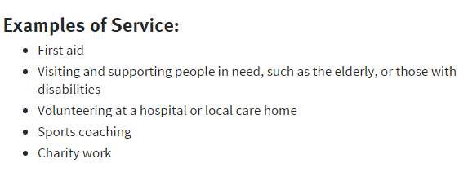

Slide 6

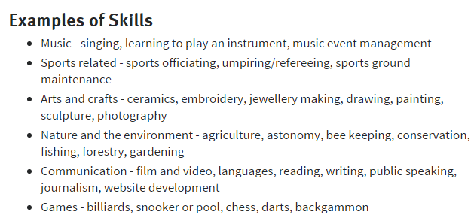

Slide 7
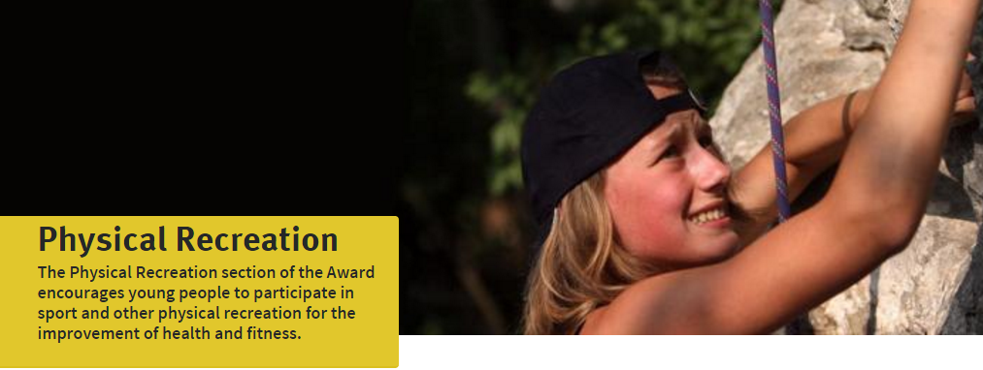
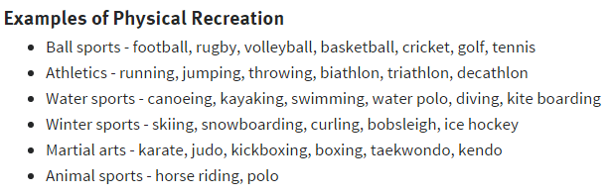

Slide 8
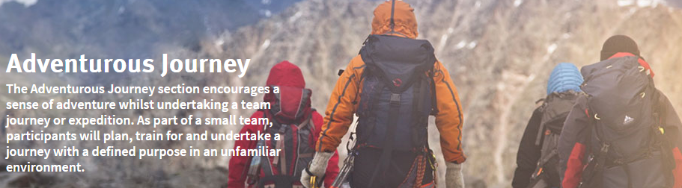
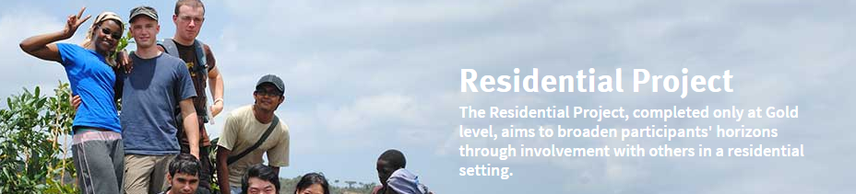
Challenges

Slide 9
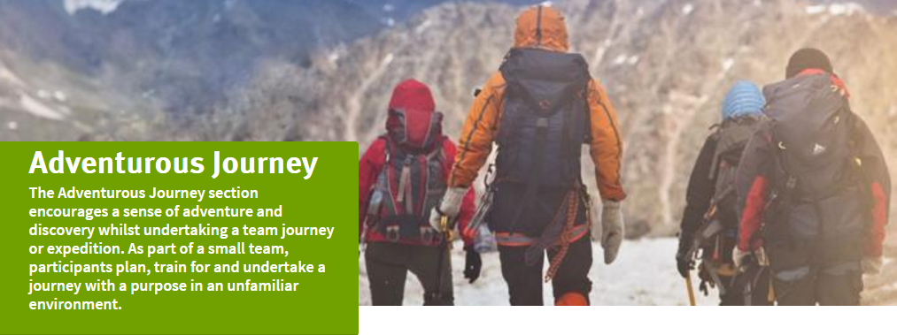
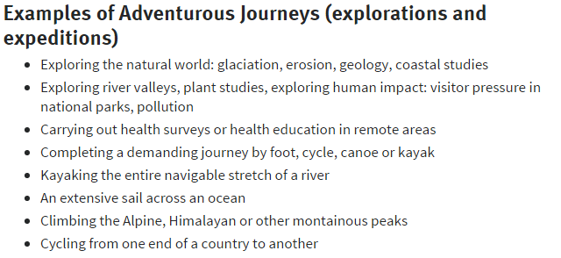

Slide 10
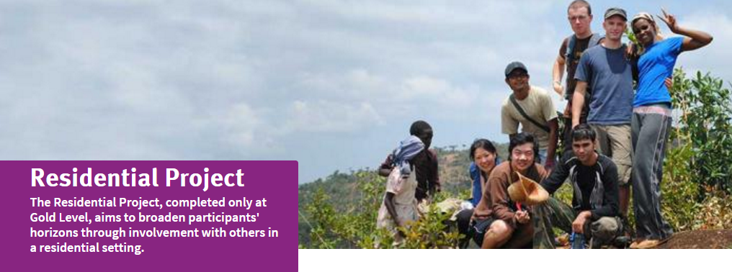
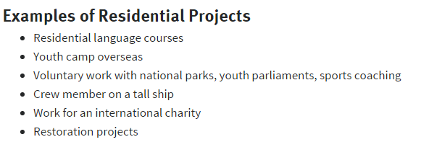

Slide 11
A new visual identity for The Duke of Edinburgh's International Award
https://www.youtube.com/watch?v=n1deE9SoO3o

