Slide 1
Creative Thinking
Teamwork

Slide 2
Definitions
A number of persons associated in a joint action
Oxford English Dictionary
Team members share goals that can be reached ONLY through the efforts of all the members
Together
Everyone
Achieves
More

Slide 3
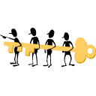
Synergy
The whole is greater than the sum of its parts
Combined individual energies produce a collective energy that goes beyond the total sum of individual contributions in a task

Slide 4
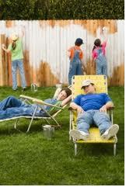
Social Loafing
Social Loafing effect: group members put in less effort as number of team members increases
Members feel that their input is not significant to the group’s overall performance
Less individual motivation

Slide 5
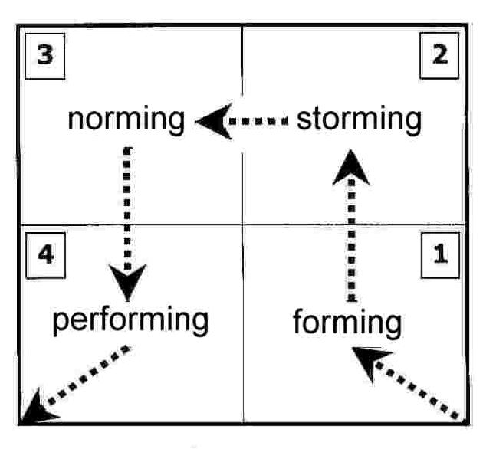
Stages in Team Development

Slide 6
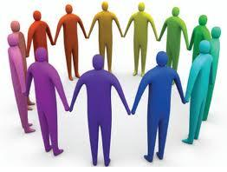
Forming and Storming
Members need guidance about their expected role in the team
May be competition for roles or rebellion against assigned tasks
Attempts to establish role in relation to other tam members and leaders

Slide 7
Norming
Roles and responsibilities are clear and accepted
Open communication within team is established
There is commitment and unity
Start to face up to the tasks in hand
There is general respect for the leader

Slide 8
Performing
A shared vision among team members
Any disagreement is resolved positively
Goal centered
Supportive, trusting, resourceful and effective
Team is able to work towards achieving the goal and maintain its unity

Slide 9
Adjourning
Adjourning is the break-up of the group, bur not all teams go through this stage
Can happen for several reasons
End of task
Personnel change
Incompatibility of members

Slide 10
Disastrous teamwork
Lack of agreement on objectives
No agreement on constraints
No agreement on decision-making process
Ineffective communication channels
Poor listening, interruptions, ambiguity
Lacking in continuity

Slide 11
Necessary Skills for Good Teams
Planning
Problem Solving and Creativity
Time Management
Organization
Delegation: assigning tasks

