Slide 1
Entrepreneurship
Economic Setups

Slide 2

Introduction
When visiting a supermarket, the list of items for sale is endless…
But when compared with what is produced all over the world the list is insignificant
Different markets which cater for all needs and wants imaginable

Slide 3
Resources
Land and Labour (workforce)
  Capital: money invested in the business
  Capital = (Assets – Liabilities)
  HRM: Human Resource Management
  HCM: Human Capital Management

Slide 4

People Management
Manpower planning
Recruitment
Training
Motivation
Industrial Relations
Employee Evaluation
Retain talented people
Assign additional responsibility to jobs
More in depth than HRM
HRM
HCM

Slide 5
Opportunity Cost
Resources are scarce…
Opportunity Cost: the cost (as a lost benefit) of the forgone products after making a choice
E.g. The opportunity cost of working additional hours is having less leisure time

Slide 6

The Three Decisions
The Consumption Decision
Who decides what to produce
The Production Decision
Who decides how it is to be produced
The Distribution Decision
For whom to produce it

Slide 7
The Four Economic Setups
Four principal economic models
Subsistence Economy
Free Market Economy
Planned/Command Economy
Mixed Economy

Slide 8
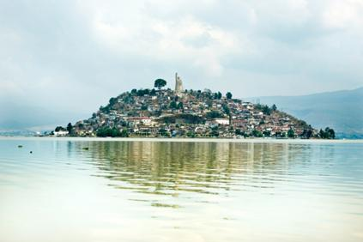
Subsistence Economy
Applicable for environmentalists
Relies heavily on natural resources
Production = consumption for the population
Concept of wealth is non-existing

Slide 9

Free Market Economy
Freedom of enterprise and choice
No government intervention in services
Maximum self interest
Demand/supply balance
Competition-oriented
Unequal distribution of wealth and resources

Slide 10
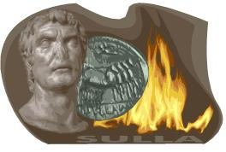
Planned/Command Economy
The State controls all business processes
A central role for the common good
Less chance of consumer exploitation
Less wasted resources
Fair distribution of wealth
Limited choices and quality
Lack of incentives to risk takers

Slide 11

Mixed Economy
A mixture of Free and Planned economy
Government intervention
  Strategic planning and incentives
  Stable prices
  Healthy Balance of Payments
  Steady economic growth

Slide 12

